Slide 1

Android SMIL Messenger
PRESENTED BY:
BENJAMIN B.
BRIAN S.
CORRY D.
CURTIS L.
JASON N.
SPENCER E.

Slide 2
Background
Mobile SMIL in the Cloud -- SMIL (pronounced "smile")
  Synchronized Multimedia Integration Language
  XML markup language for describing multimedia presentations
  Defines markup for timing, layout, audio, and visual presentations
  The SMIL language supports displaying media such as
    Text
    Image
    Audio
    Video
  timing controls
    begin time
    end time
    duration
Currently, there are some SMIL players available
  Realplayer
  Quicktime
  Windows Media player classic
However, there are very few SMIL players available for mobile devices.
Brian

Slide 3
Introduction
Business value from developing a Mobile SMIL message system
The system should consist of
  SMIL composer
    Create a new SMIL message
    Edit a SMIL message
    Save a SMIL message
    Preview a SMIL message
    Send a generated SMIL message to other mobile devices
  SMIL player
    Receiving a SMIL message
    Opening a SMIL message
    Playing a SMIL message
      Pausing the play
      Resuming the play
      Stopping the play
This system could be considered as a peer-to-peer system
Acts as the roles of both the sender and receiver.
Brian

Slide 4
Introduction (continued)
Android 2.1 or later version
Provides a multimedia messaging system
Allow users to communicate with each other
Enables the sharing of
  Audio
  Pictures
  Text
  Videos
Cloud technology
Follows SMIL specifications.
Brian

Slide 5
Group
Member | Role | Get To Know Us
Benjamin B. | Project Manager Architecture Liaison SVN Admin | AMIG Fights crime at night
Brian S. | Developer Tester | Heritage Propane
Corry D. | Applications Admin Developer | Walgreens All around nice guy
Curtis L. | User Experience Extraordinaire Tester | Full-Time Student Monster Energy Consultant
Jason N. | Designer/Developer Configuration Commander | Frequent Traveler
Spencer E. | Senior UML Designer Developer in the Clouds | STEM Ambassador Like long walks on the Cloud
Curtis

Slide 6

The Technology
Eclipse
  Helios
  Android SDK
  App Engine Plug-in
  Subclipse
Android 2.1 and 2.2
  Emulator
  Phone
Google
  App Engine
    https://appengine.google.com/dashboard?&app_id=csc440
    App Engine SDK
  Code
    http://code.google.com/p/csc440-smil-player/
Curtis

Slide 7
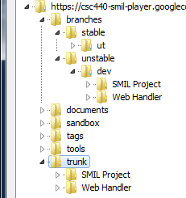
Technology (continued)
Source Code Management
  Subversion
    Tortoise
    Subclipse
  Beyond Compare
SVN Structure
  f
Photoshop
  Buttons
  Mock ups
Argo
  UML Diagrams
Slime (Eclipse Plug in)
  UML Diagrams
Stackoverflow.com
Curtis

Slide 8
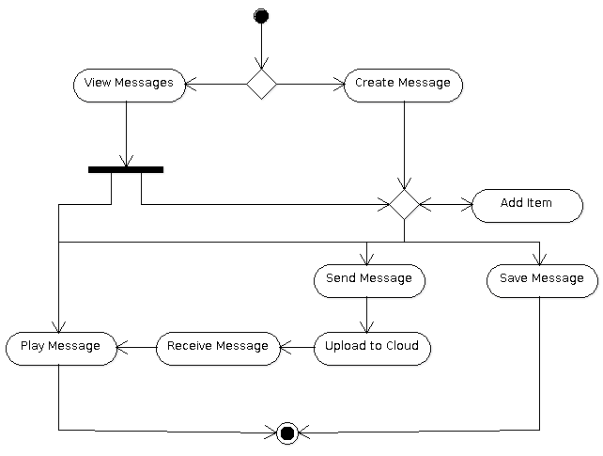
Hao, it works!
Can create, view, or send a message
Create
  Add to Canvas
View
  Load in player
Send
  Upload 2 Cloud
Spencer

Slide 9
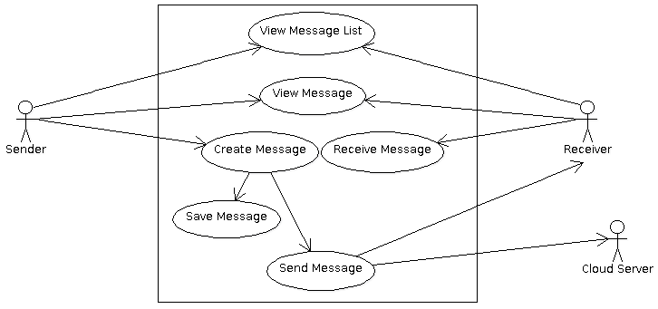
Use Cases
Three actors
  Sender
  Receiver
  Cloud Server
Sender and Receiver have similar interactions with the main application functions
Cloud Server is the middle man
Spencer

Slide 10
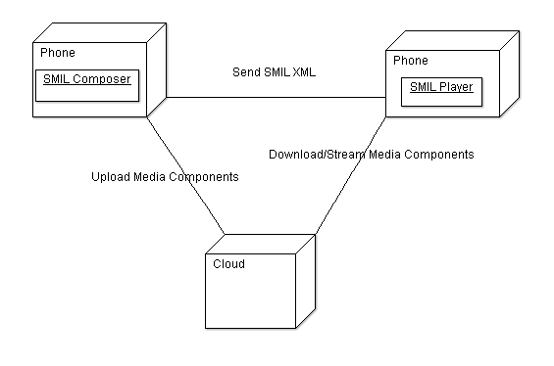
Deployment Diagram
Phone sends message
  Send SMIL file name through text message
  Uploads SMIL file and media files to cloud
Phone receives message
  Receive file name from text message
  Parse file for file names of files on cloud
  Download files
Spencer

Slide 11
To the Cloud!
Why Cloud?
  Need a service that will handle sending SMIL files and the attached media
How it works?
Download | Upload
Make GET Request | Make GET Request
Passing key or file name | Receive url to upload file
Receive File | Make POST request to url
 | Receive Key for file from Blobstore
Spencer

Slide 12
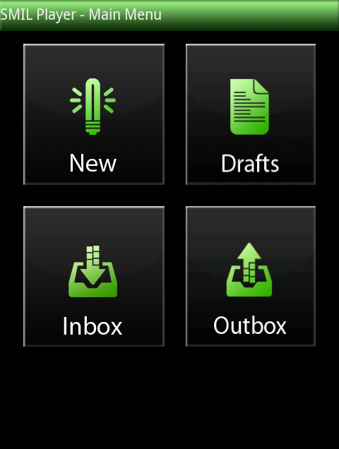
GUI – HOME
New
  Opens the composer to create a message from scratch
Drafts
  Show list of messages saved
Inbox
  Show list of received messages
Outbox
  Show list of sent messages
Corry

Slide 13
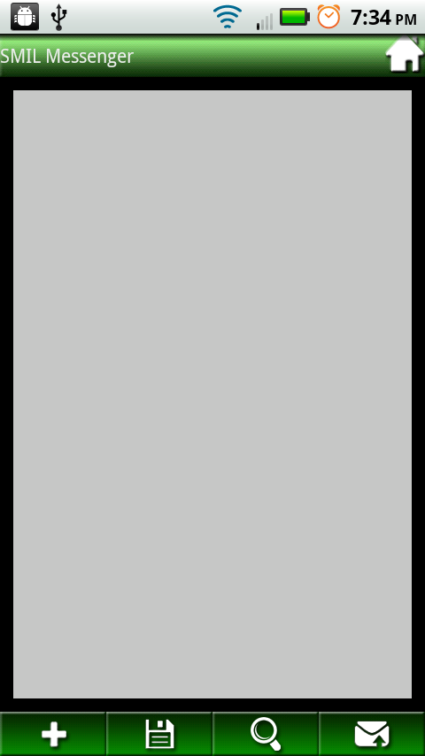
GUI - Composer
Add
Save
  Generates current state of message into a SMIL file and stores it in drafts
Preview
  Loads current state of the message into the player
Send
Drag and drop functionality
Corry

Slide 14
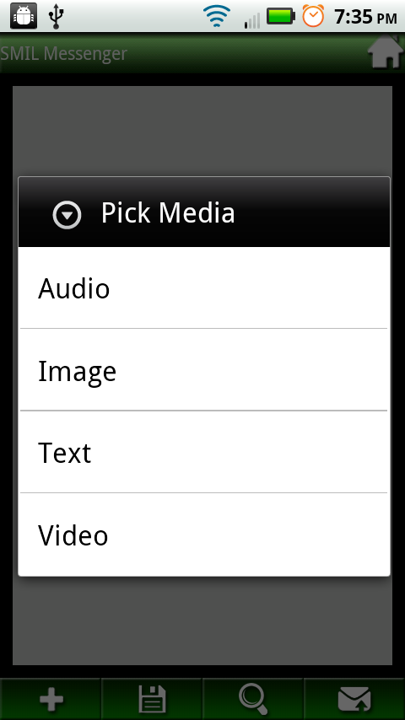
GUI – Composer (Add)
Add
  Audio
    Browse Chooser
    3rd party application
  Images
    Browse Chooser
    3rd party application
  Text
  Video
    Gallery
Corry

Slide 15
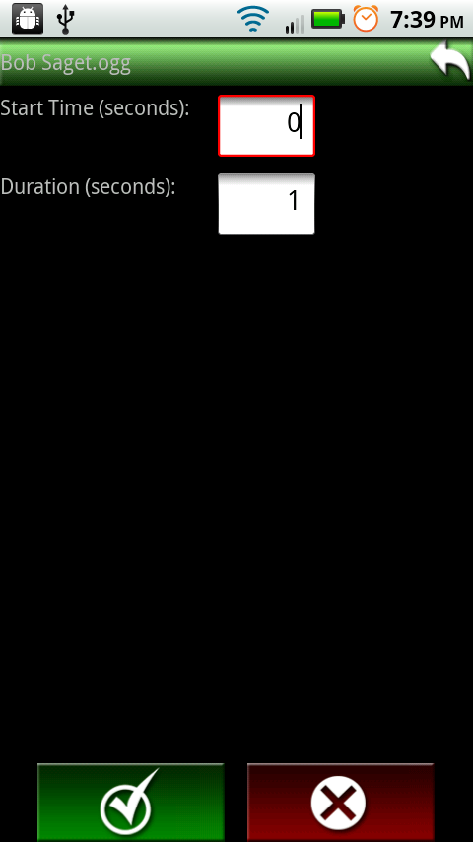
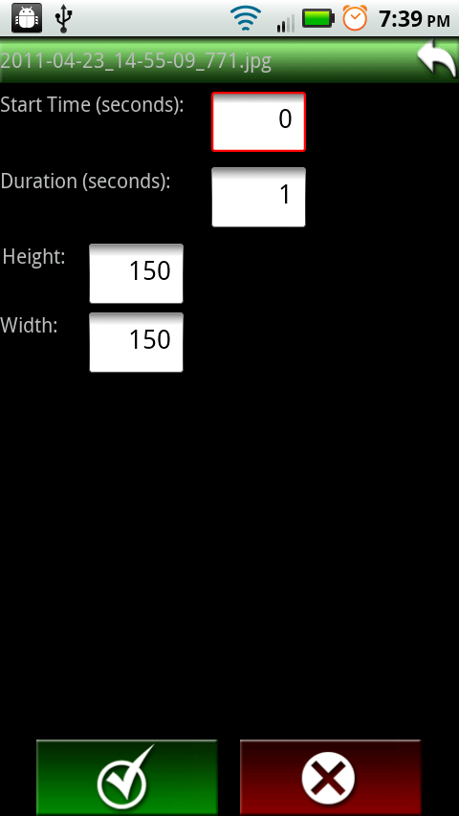
GUI – Media Properties (Audio, Image)
Curtis

Slide 16
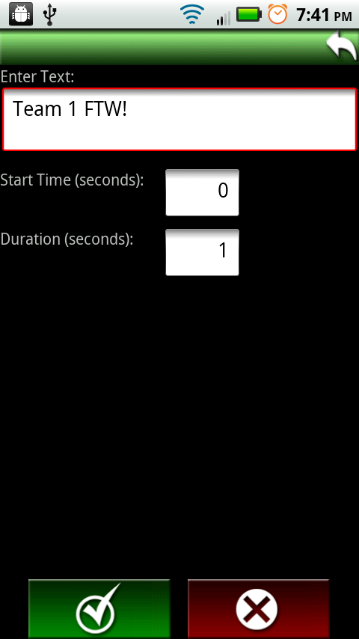

GUI – Media Properties (Text, Video)
Curtis

Slide 17
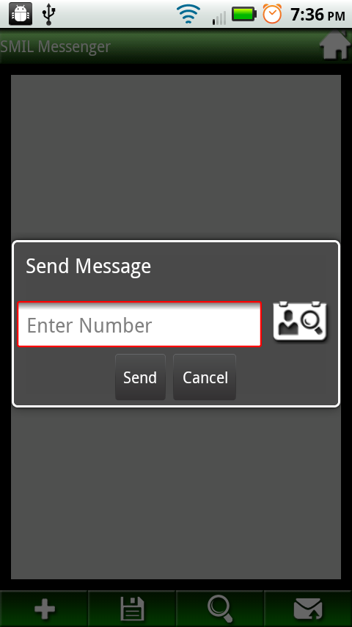
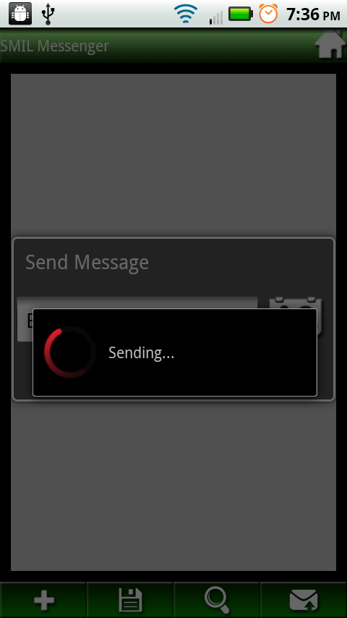
GUI – Composer (Send)
Corry

Slide 18
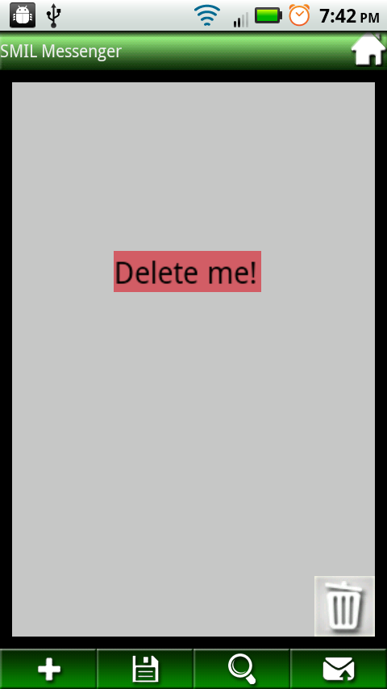
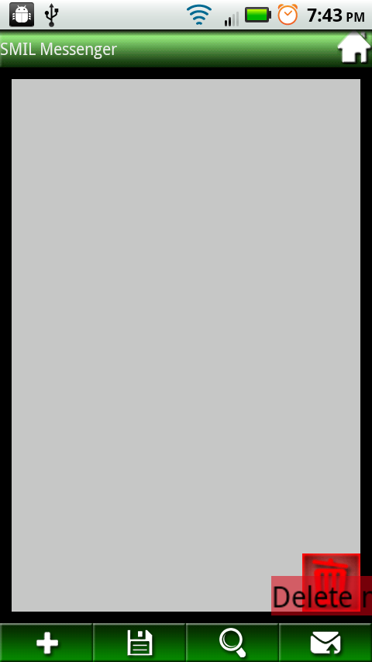
GUI – Composer (Deleting)
Corry

Slide 19
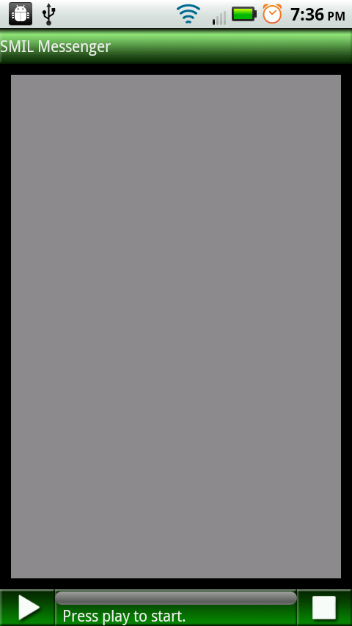
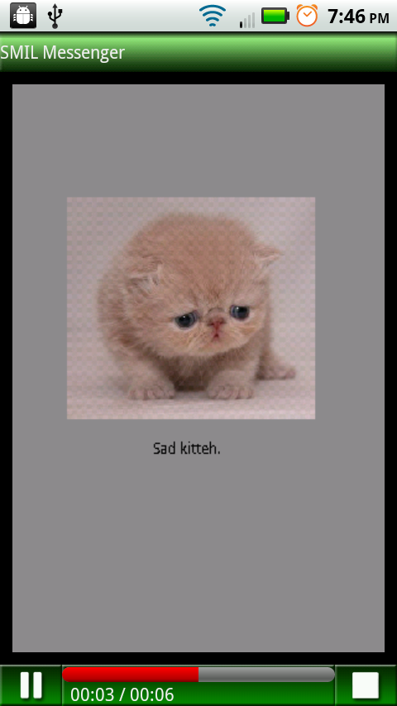
GUI - Player
Plays a SMIL file
  Parses XML
  Sets up viewer
  Load media components
  Starts Media Threads
Jason

Slide 20
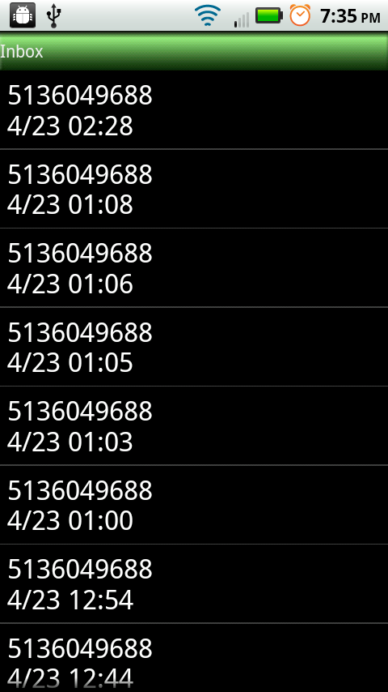
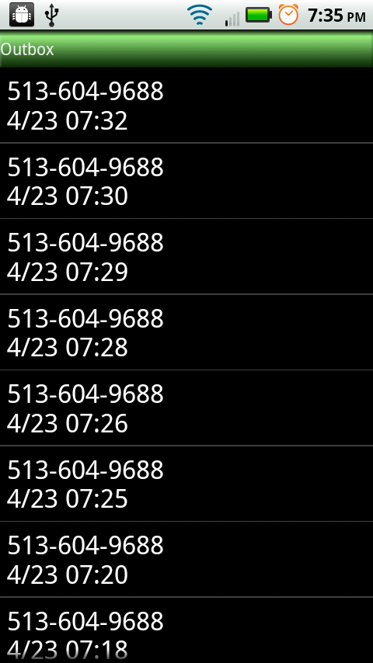
GUI – Inbox vs. Outbox
Jason

Slide 21

GUI – Drafts
Created from Composer
  Trigger -- save button
Generated SMIL
Display list of files in draft folder
Jason

Slide 22

Testing
Phase 1
  Manual Testing
    Add Media to composer
      Several sets of Combinatorics
    Play Message
      Several sets of Combinatorics
    Send/Receive
  Negative Testing
    Bad Input
      Special Charaters
Phase 2
  Integrate JUnit testng
Brian

Slide 23
Challenges
Problems
Answers
Progress Bar
MultiThreading
Android behavior
Receive messages
Downloading
Amount of work
Deadlines
Hard work
Research techniques
Restart
Work around Broadcast Receiver
MultiThread it
Dealt with it
Asked for forgiveness

Slide 24
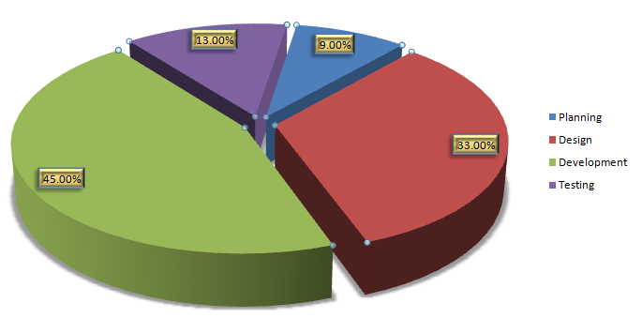
Task Partition

Slide 25
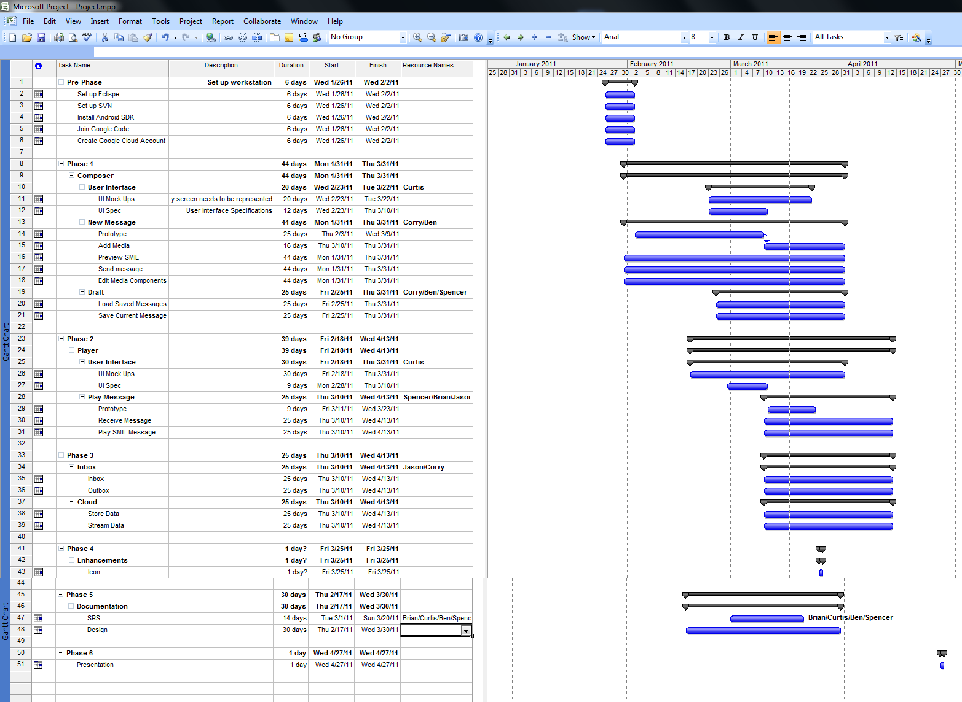
Project Work Schedule

Slide 26
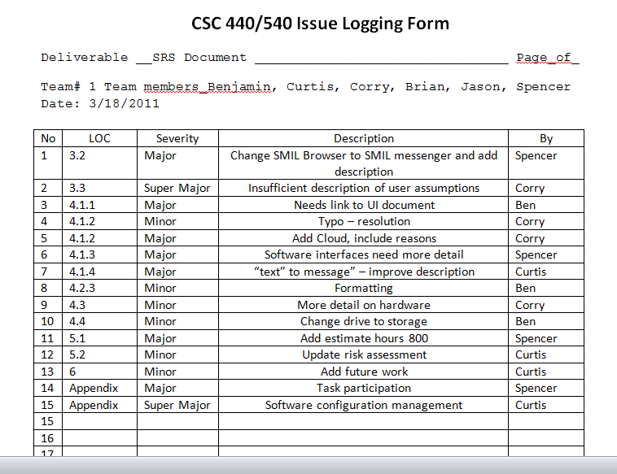
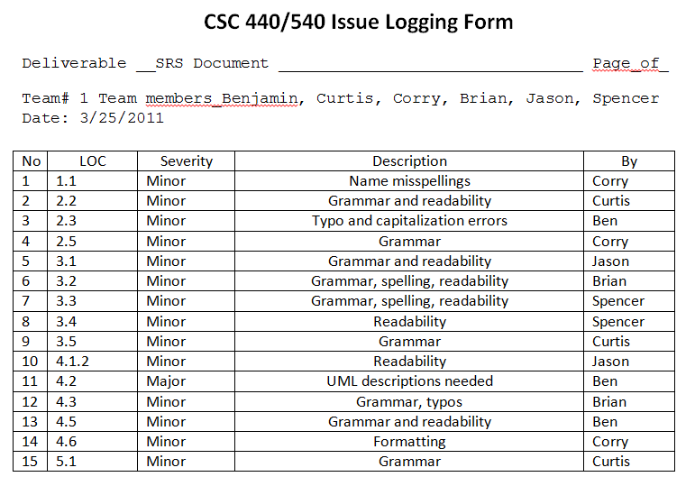
Inspection

Slide 27
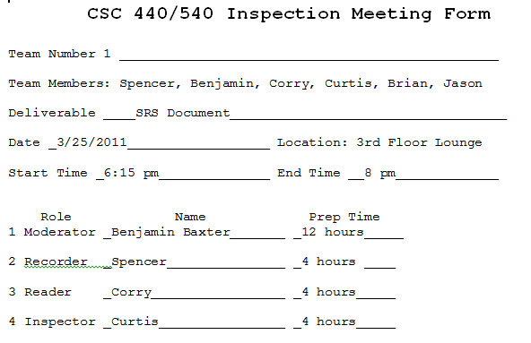
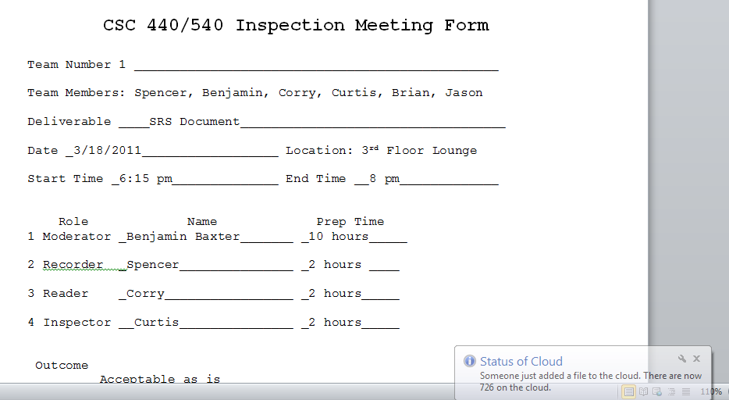
Inspection

Slide 28
Communication
Emails
  Send to Google group that everyone joined
Text Messages
  Quick and dirty way of conveying status between 2 people
Meeting Agenda and minutes stored in a documents folder in SVN
Phone calls
Verbally

Slide 29

Conclusion

Slide 30
Conclusion
Inspired by this project, we are motivated to keep improving upon this initial product.
We are calling this Phase 1 and have several ideas for a Phase 2. Idea such as:
  Undo function in composer
  Account for users on the cloud
  Improve security
This was a great experience and applying the SDLC to a programming project has been very enlightening.

Slide 31

Demo

Slide 32
Q/A
Questions?

